Slide 1



Data Mining: Unlocking Insights from Real-World Examples
Data mining is the process of extracting valuable insights from large datasets. It involves using statistical techniques and algorithms to identify patterns, trends, and relationships within the data, enabling businesses to make better decisions and achieve greater success.
Notes:
1

Slide 2
Understanding Data Mining: What It Is and How It Works
Data Collection
Data Cleaning
Data Analysis
Data Visualization
The first step involves gathering relevant data from various sources, such as databases, web logs, social media, and sensors. This data can be structured or unstructured, numerical or categorical.
Once collected, the data needs to be cleaned and preprocessed. This involves removing inconsistencies, handling missing values, and transforming data into a suitable format for analysis.
Next, powerful algorithms are applied to analyze the cleaned data, uncovering patterns, trends, and relationships. These algorithms can include classification, clustering, regression, and association rule mining.
The final step involves presenting the findings in a clear and concise manner, often using charts, graphs, and dashboards, making it easy for decision-makers to understand and interpret the results.
Notes:
2

Slide 3
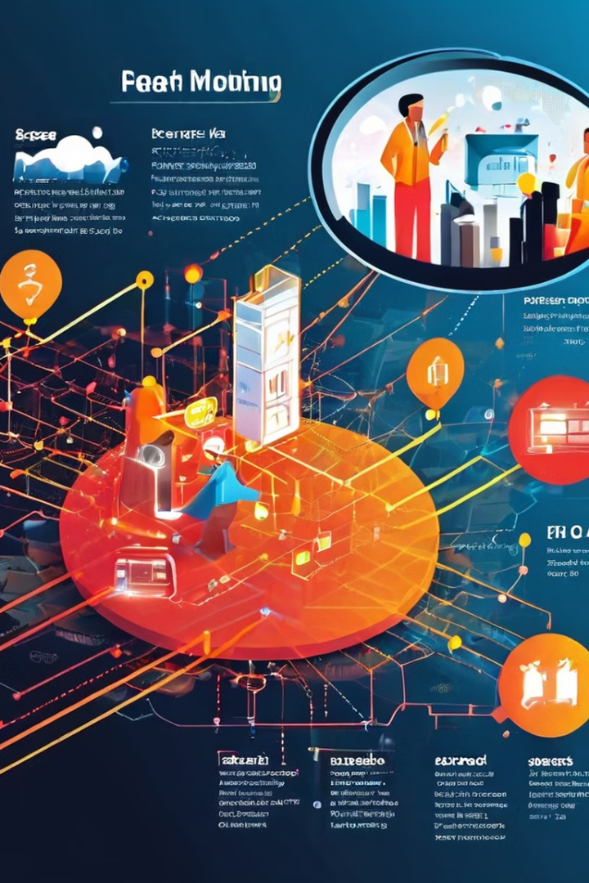
Real-Life Data Mining Applications: Improving Efficiency and Customer Service
1
Fraud Detection
2
Personalized Recommendations
Banks use data mining to identify fraudulent transactions by analyzing spending patterns and identifying anomalies, helping prevent financial losses and protecting customers.
E-commerce platforms like Amazon and Netflix leverage data mining to understand customer preferences and suggest relevant products or movies, enhancing customer satisfaction and increasing sales.
3
Customer Segmentation
Companies use data mining to segment customers into groups based on demographics, purchasing behavior, and preferences, enabling them to tailor marketing campaigns and improve customer service.
Notes:
3

Slide 4



Leveraging Data Mining for Recruitment and Geographical Insights
Recruitment
Geographical Insights
Data mining helps companies analyze candidate profiles, identify top talent, and optimize recruitment strategies, leading to a more efficient and effective hiring process.
Data mining is used to analyze geographic data, such as population density, demographics, and market trends, helping businesses make informed decisions about location selection, marketing campaigns, and resource allocation.
Notes:
4

Slide 5

Conclusion: Harnessing the Power of Data Mining for Business Success
Data mining is a powerful tool that can help businesses gain a competitive advantage by unlocking valuable insights from data, improving efficiency, enhancing customer service, driving innovation, and making informed decisions for future success.
Notes:
6

